Slide 1
Made in Hyeon bin's Hand
Open MM Lab practice
Agenda
Open-MMLab
mmdetection
mmdetection Mask R-CNN – on CPU
2022.11.30
경기대학교 AI컴퓨터공학부
발표 팀 | Team 8
발표자 | 손현태

Slide 2

Made in Hyeon bin's Hand
I. OpenMMLab
Title

Slide 3
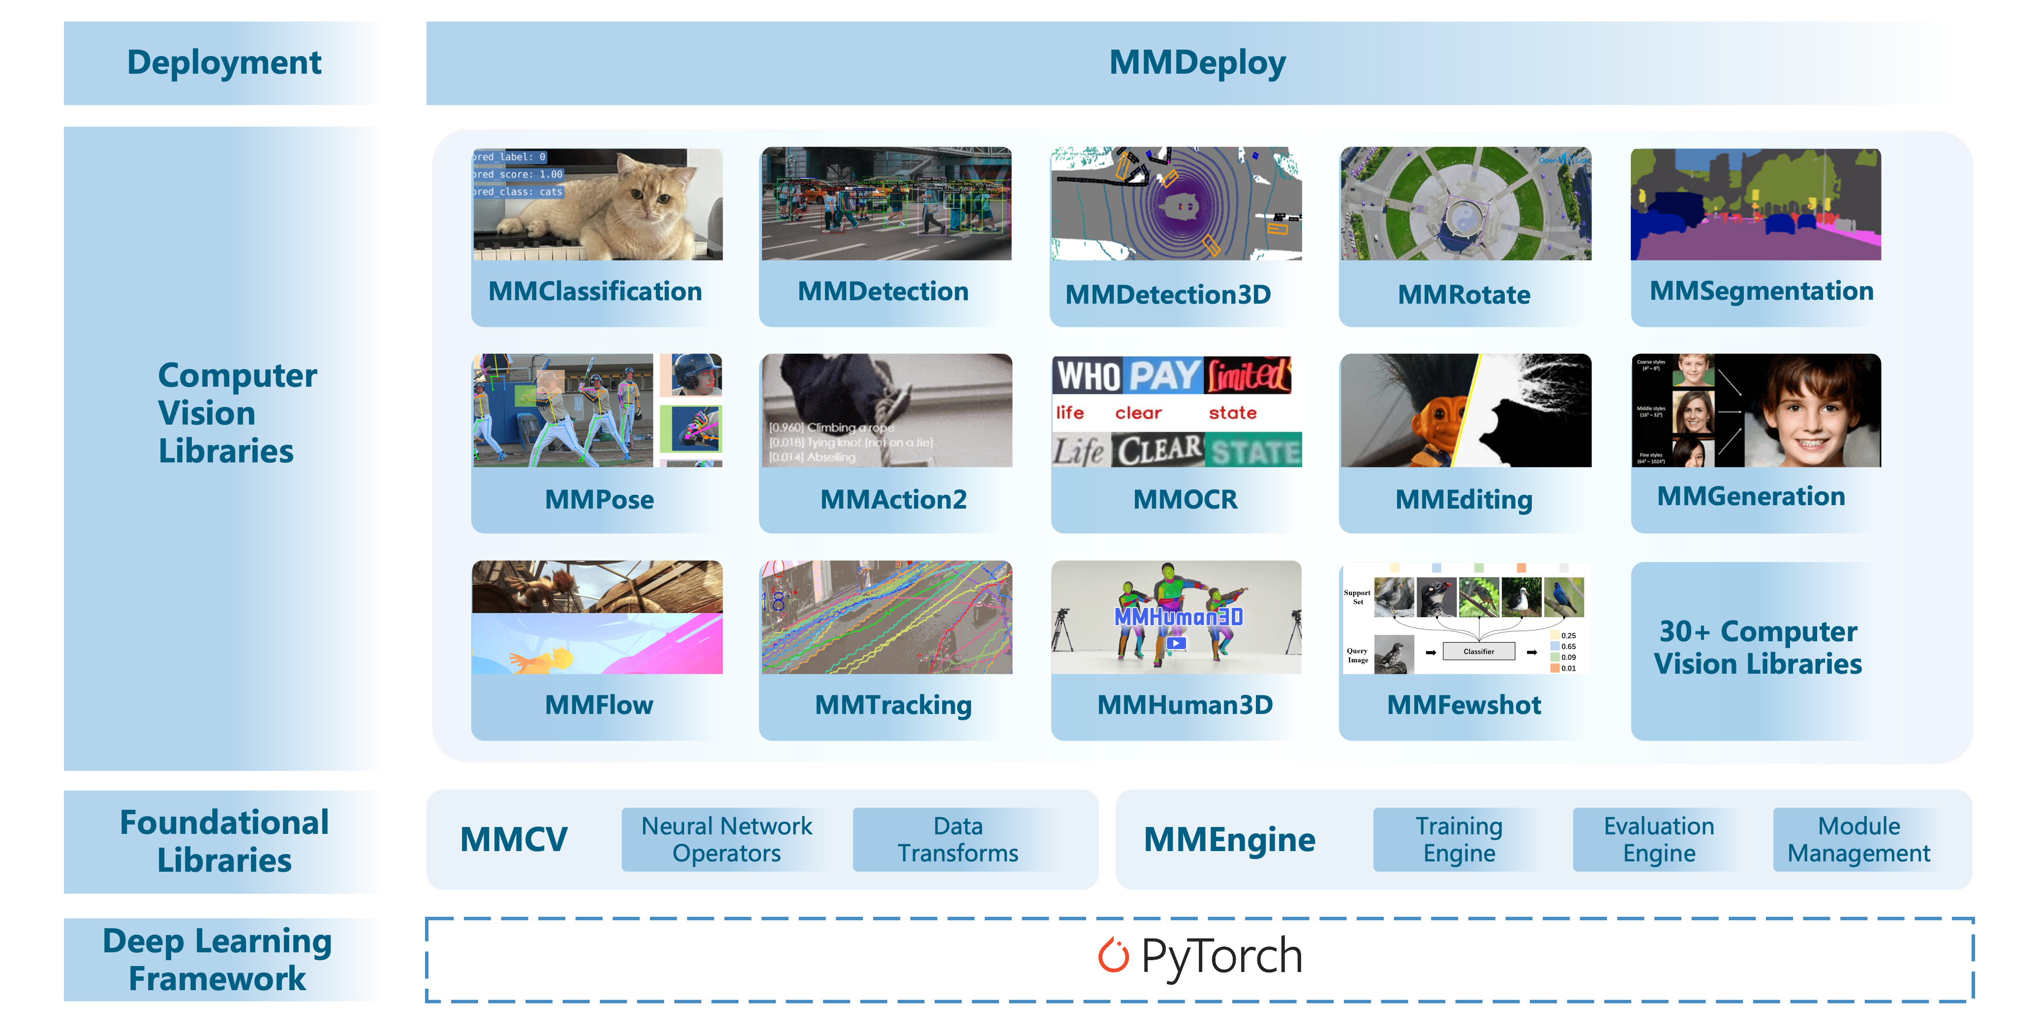
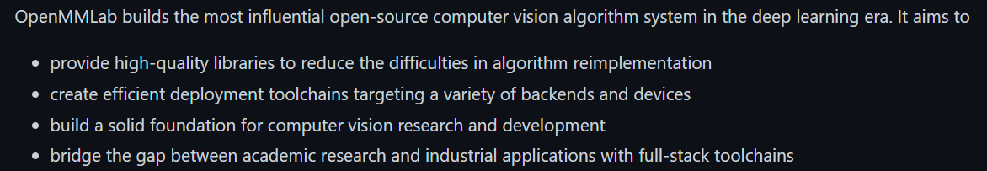
Section Open-MMLab
-----
Made in Hyeon bin's Hand

Slide 4
Section Open-MMLab
-----
Made in Hyeon bin's Hand
Classification / Localization / Segmentation
Optical Flow
Video Perception
Pose Estimation

Slide 5
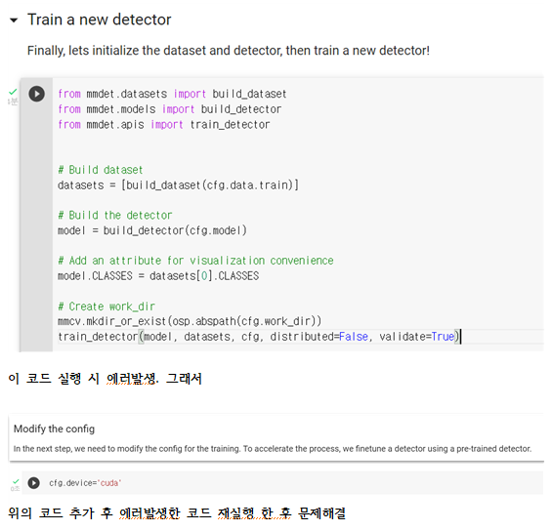
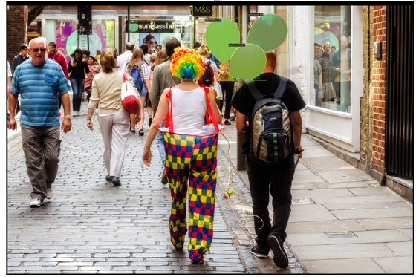
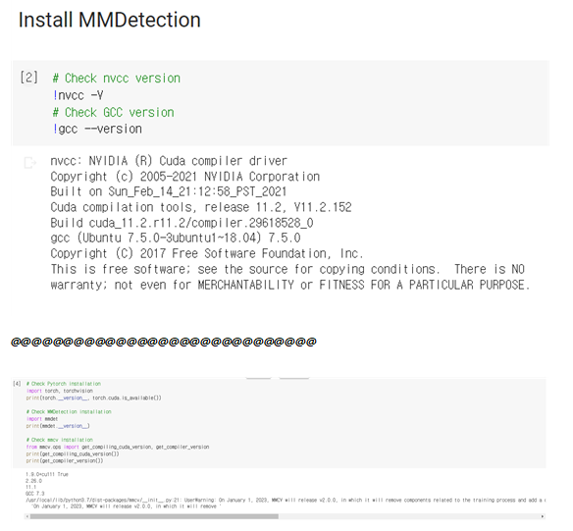
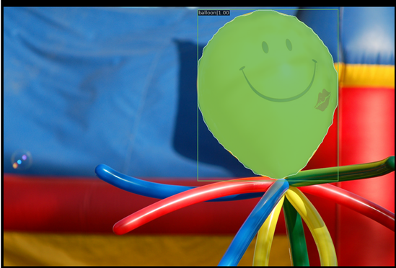
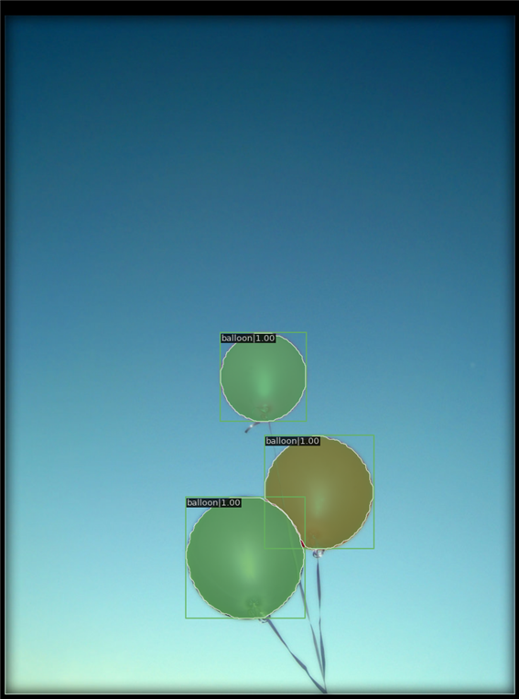
Section mmdetection Mask R-CNN – on CPU
-----
Made in Hyeon bin's Hand
Figure Section
Fig N. Description

